Slide 1

Introduction
to
Computer Science
CS101.3
Lecture #05

Slide 2
Welcome to Lecture 05 !
Take your notebooks and prepare
You can ask questions via either chat message or over the mic.
When you are not using the mic please mute it.

Slide 3

From Last Week
Hex Number System

Slide 4
Hexadecimal Number System
Hexadecimal number system also known as hex number system is in the base of 16
In Hexadecimal number system there should be sixteen different symbols to represent numbers hence this number system is quite complicated when considering with other number systems which we have discussed so far.
The symbols are 0,1,2,3,4,5,6,7,8,9,A,B,C,D,E and F.
Meaning of above mention characters are numbers with two digits means numbers from 10 to 15.
A-10, B-11, C-12, D-13, E-14, F-15
2F5A₁₆

Slide 5
Hexadecimal Calculations >> Addition
By using Hexadecimal numbers it’s capable of performing mathematical calculations.
Example
4₁₆ + A₁₆ = 4 + 10
= 14
E₁₆

Slide 6
Hexadecimal Calculations >> Addition
Example
2C₁₆ + A7₁₆
₁
A=10, B=11, C=12, D=13, E=14, F=15
2 C
A 7 12 + 7 =19
D 3 19-16 = 3
Answer is D3₁₆

Slide 7
Hex Number System
Exercise
Perform following calculations
78₁₆ + 45₁₆
12A₁₆ + AB₁₆
EF10₁₆ + ABC₁₆

Slide 8
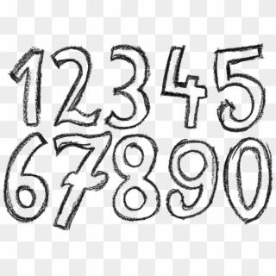
Number Representation

Slide 9
Storing Numbers in Computer
In a Software like Notepad, numbers we are entering will store as letters by using their respective ASCII codes.
But in a Software like Calculator, it should store as a value since we need to do some calculations with the

Slide 10
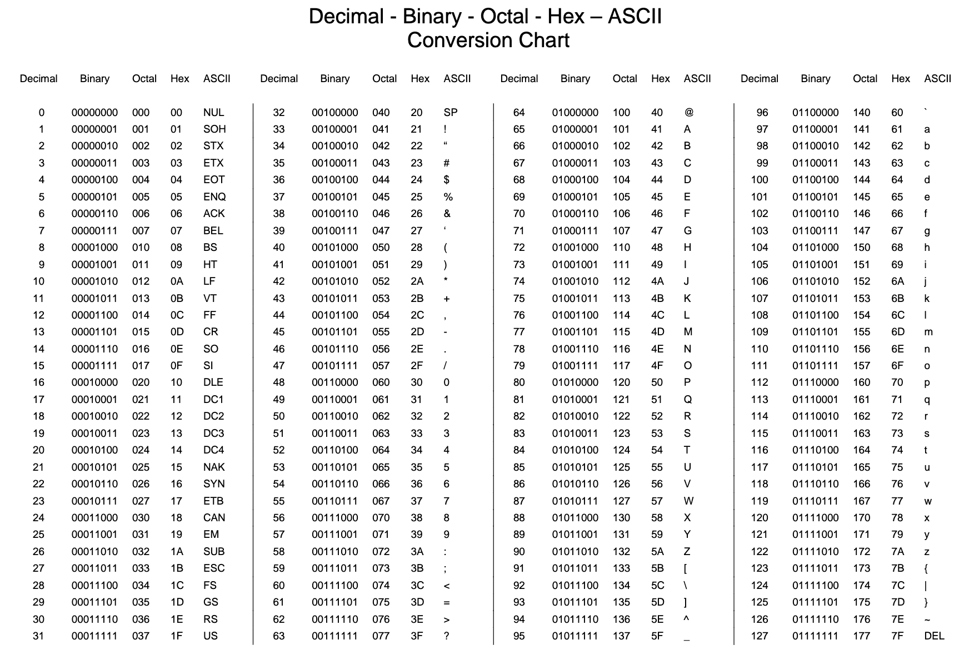

Slide 11
Storing Numbers in Computer
Method 01 – BCD (Binary Coded Decimal)
In this method each digit (decimal digit) is stored in four digits of binaries.
In this method the sign of the number cannot represent. Cannot represent whether the number is positive or negative.
Example
1522
1 5 2 2
0001 0101 0010 0010

Slide 12
Storing Numbers in Computer
Method 01 – BCD (Binary Coded Decimal)
Task 01
Convert following number to BCD format
2345
7842
992
0920
+534
-534

Slide 13
Storing Numbers in Computer
Method 02 – Zone Decimal
In this method special type of representation being used.
This method use a special character call ‘Z’ which has a specific binary value.
In this method the sign of the number can represent.
Z = 1111
+ = 1100
- = 1101
Example
+534
Z 5 Z 3 + 4
Z 5 Z 3 + 4
1111 0101 1111 0011 1100 0100

Slide 14
Storing Numbers in Computer
Method 02 – Zone Decimal
Task 02
Convert following number to Zone Decimal format
+3345
-6822
-192
920
+534

Slide 15
Storing Numbers in Computer
Method 03 – Packed Decimal
In Packed Decimal number representation, it uses the sign at the end of the binary conversion.
+ = 1100
- = 1101
Example
+534
5 3 4 +
0101 0011 0100 1100

Slide 16
Storing Numbers in Computer
Method 03 – Packed Decimal
Task 03
Convert following number to Packed Decimal format
+8723
-9902
-1910
9991
+789

Slide 17
Storing Numbers in Computer
Method 04 – Ones Complement Representation
In this method convert decimal number to binary and make sure it has 8 digits (8 bits) which represent a one byte.
This method also known as 8 bits ones complement representation.
Example
Convert +7 to ones complement representation
7 = 111
+7 = 00000111

Slide 18
Storing Numbers in Computer
Method 04 – Ones Complement Representation
Task 04
Convert following number to Ones Complement Representation
+23
+12
+32
+15

Slide 19
Storing Numbers in Computer
Method 04 – Ones Complement Representation
with negative numbers
When you get a negative number first you should convert it to it’s binary equivalent with 8 digits (8 bits ones complement)
Then convert 0s into 1s and 1s into 0s.
Its also know as subtracting the 8 bits ones complement value from full value (8 one’s)
Example
Convert -7 to ones complement representation
7 = 111
+7 = 00000111
-7 = 11111000

Slide 20
Storing Numbers in Computer
Method 04 – Ones Complement Representation
Task 05
Convert following number to Ones Complement Representation
-23
-18
-22
-25

Slide 21
Storing Numbers in Computer
Method 04 – Ones Complement Representation
When the binary pattern is given how to find the decimal value
00001000
11111001

Slide 22


